Slide 1
UML : Unified Modelling Language

Slide 2
Visual Representation of a System
System == an app || website || game|| etc.

Slide 3
Use Case Diagram
At it’s simplest is a representation of users interaction with the system that shows the relationship between the user (actor) and different use cases in which the user is involved.

Slide 4
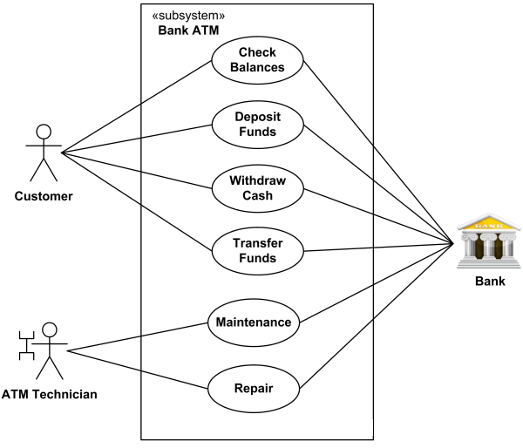
Example:

Slide 5
Components
SYSTEM
ACTORS
USE CASES
RELATIONSHIP

Slide 6
Actor
PERSON
ORGANIZATION
ANOTHER SYSTEM
EXTERNAL DEVICE
Primary – Initiates use of System (Left)
Secondary – Reactionary
(Right)

Slide 7
Use Case
Represents an action that accomplishes some sort of task within the system
Represented with and is placed inside the rectangle (system).
Example : Log In , Check Balance , Transfer Funds, Make Payment – “Verbs”
Maintain Logical Sequence

Slide 8
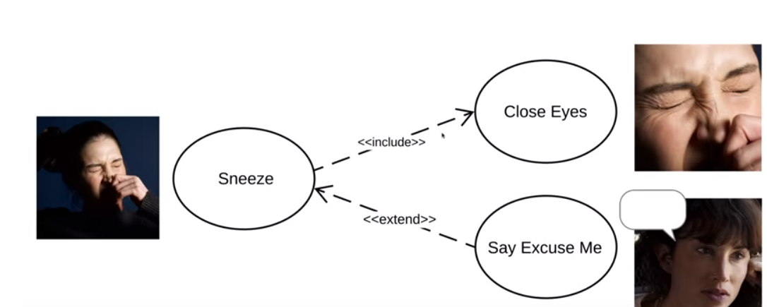
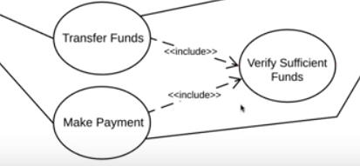
Relationship
Association – represented by solid line – represents basic communication or interaction
Include Use Case: shows dependency between base use case and included use case. Represented by dash line -→ from base use case to included use case (Everytime)
Login ------<<include>> ----→ Verify Password
Extend Use Case: a case which may or may not initialize based on the reaction from Base Case (Sometimes activated). Represented by dash line from extended case to base case
Multiple base cases can point to same included use case

Slide 9
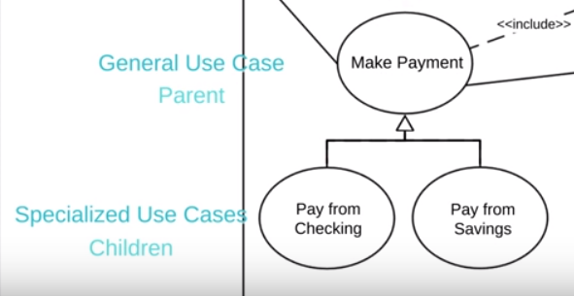
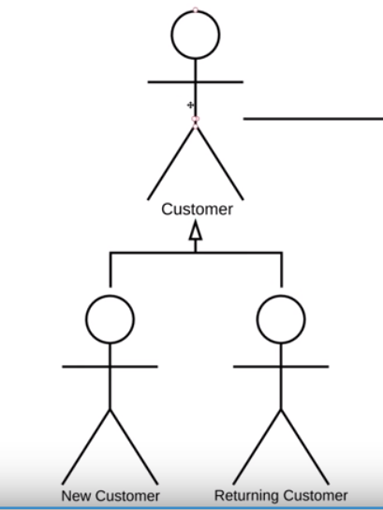
Generalization

Slide 10
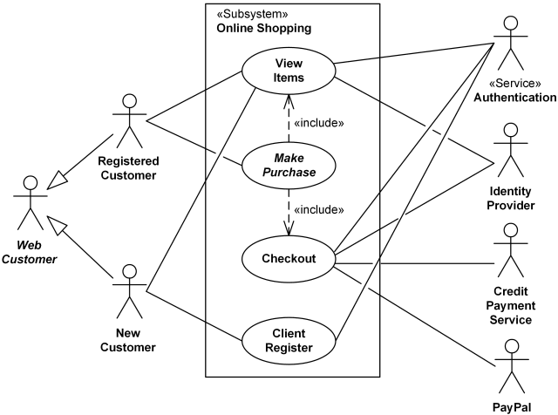
Another Example

Slide 11
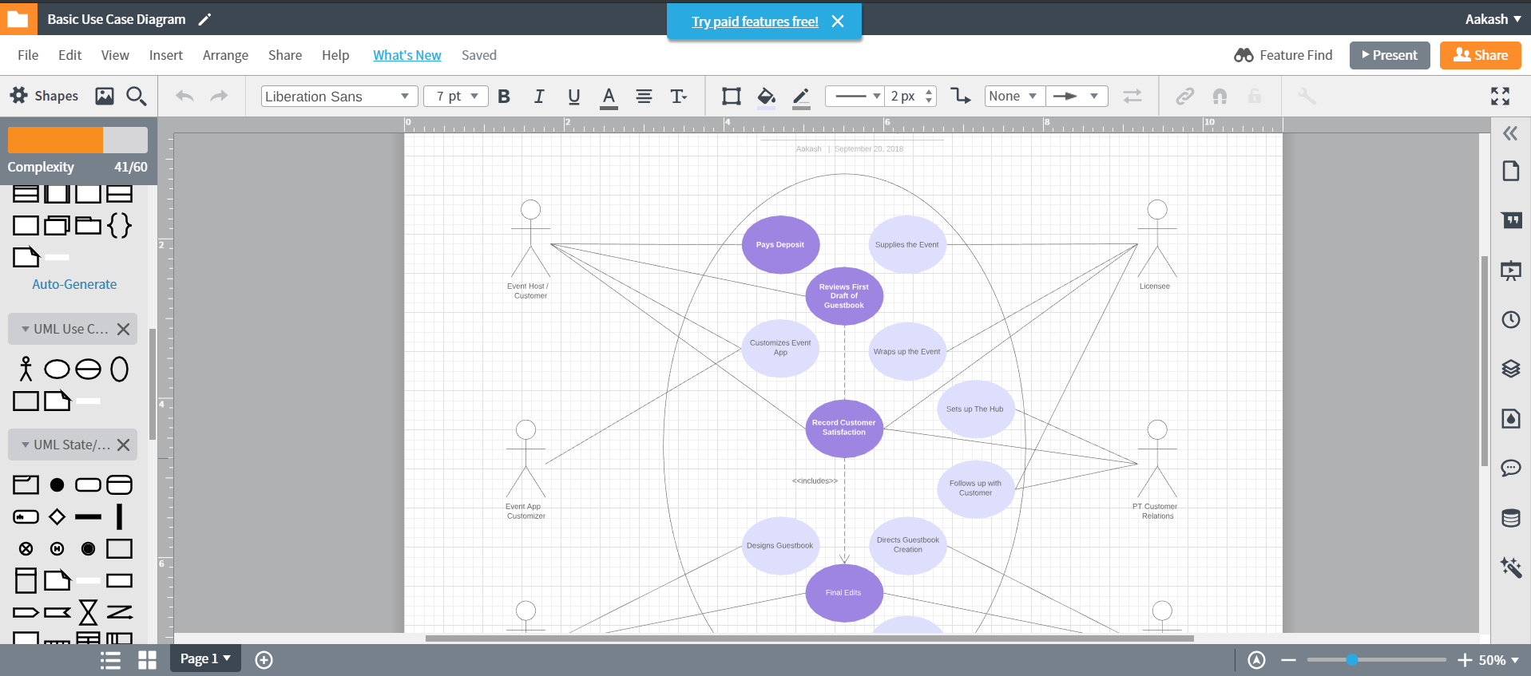
Lucidchart.com

